Slide 1
PHISHING ATTACK DETECTION USING MACHINE LEARNING ALGORITHMS
Team Details:
RAYASAM DIVIJA (20EG105439)
VADDE MAHESH REDDY (20EG105448)
ENUGALA VISHNU VARDHAN REDDY (20EG105720)
Project Supervisor
Name: T. Srikanth
Designation: Assistant Professor Dept of CSE

Slide 2

Introduction
Phishing is a Cyber Attack where deceptive emails or messages that mimic reputable sources, aiming to trick recipients into revealing personal information by clicking malicious links.
This project addresses phishing attack detection using hybrid machine learning techniques including Random Forest, Gradient Boosting,
Logistic Regression and SVM.
Focused on Email and SMS phishing, the system analyzes patterns to proactively identify threats and calculates a risk factor for incoming messages.
It has applications like Enterprise email security, Telecommunications, Government, Health care and many more…

Slide 3
Literature
Author(s) | Method | Advantages | Disadvantages
R. Verma, N.Shashidhar, N.Hossain | The method involves utilizing natural language processing techniques, distinguishing between actionable and informational emails, using the implemented tool "PhishNet-NLP" to intercept and analyze incoming emails for phishing attacks. | The scheme enhances phishing email detection using natural language techniques and contextual cues, surpassing existing methods through intent analysis and content differentiation. | The scheme enhances phishing email detection using natural language techniques and contextual cues, surpassing existing methods through intent analysis and content differentiation.
A. Almomani, B. B. Gupta, S. Atawneh, A. Meulenberg, E. Almomani | The paper surveys and evaluates various protection methods against phishing emails, particularly focusing on machine-learning techniques. | The paper offers a comprehensive overview and evaluation of phishing email detection methods, highlighting machine-learning techniques and aiding understanding for future research directions. | The survey might become outdated quickly due to the rapidly evolving nature of phishing techniques and cybersecurity measures.
S. Salloum, T. Gaber, S. Vadera, K. Shaalan | The study employs a comparative analysis of state-of-the-art NLP and ML strategies for detecting phishing emails, assessing their effectiveness at different stages of the attack. | The study offers a comprehensive analysis of NLP and ML techniques for detecting phishing emails, providing insights for improving email security | The study's effectiveness might be limited by the rapidly evolving tactics used by cybercriminals, potentially requiring continuous updates to its techniques.
W. Niu, X. Zhang, G. Yang, Z. Ma, Z. Zhuo | The CS-SVM method integrates Cuckoo Search optimization with SVM to enhance parameter selection for Radial Basis Function and improve phishing email detection accuracy | The CS-SVM model combines Cuckoo Search and SVM to achieve a 99.52% accuracy in detecting phishing emails, outperforming default SVM classifiers. | The proposed CS-SVM model's effectiveness might be sensitive to the choice of dataset and may not generalize well to all types of phishing attacks.

Slide 4

Problem Statement:
To Design a machine learning-based model using Algorithms to detect phishing attacks in Emails and SMS, safeguarding users and organizations against fraudulent attempts to acquire sensitive data.
Objective:
To Create the robust and accurate phishing detection model that can identify suspicious Emails and SMS messages reducing the risk of data breaches, financial losses and also calculates risk factors, performance and reliability.

Slide 5
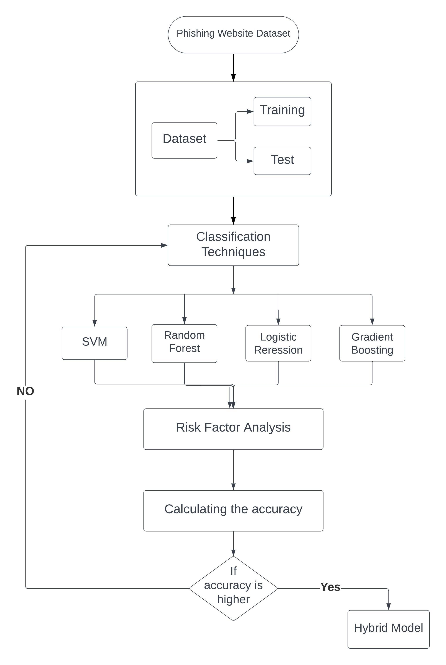
Proposed Method
Training Phase:
The training phase aims to build machine learning models that can differentiate between legitimate and phishing messages.
Data Collection:
Gathering a labeled dataset of Email and SMS messages. This dataset is taken from the Kaggle which contains both spam and legitimate messages.
Features Extraction:
We will convert the raw email or SMS data into numerical features that numerical algorithms can work with, TF - IDF (Term Frequency - Inverse Document Frequency), Word Embeddings.
Feature Selection:
Selecting the methods to reduce dimensionality and improve model performance. Feature selection methods like feature importance from Random Forest and Gradient Boosting, Recursive Feature Elimination (RFE) and Regularization.

Slide 6
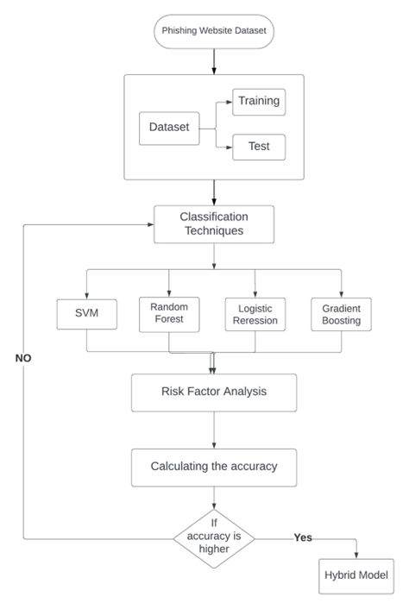
Proposed Method
Model Selection:
Selecting a Hybrid approach combing the algorithms Random Forest + Gradient Boosting + Logistic Regression + SVM Model.
Training:
Each algorithm (Random Forest, Gradient Boosting, Logistic Regression, and Support Vector Machine) is trained separately using a labeled dataset.
The algorithms learn from the data and aim to create models that can predict whether a given message is legitimate (0) or phishing (1) which is weighted voting and we also use stacking.
Model Evaluation:
Evaluating the model on a validated dataset, using metrics such as accuracy, precision, recall, F1-score, and ROC-AUC.2 .

Slide 7
Proposed Method
Risk Analysis Phase:
The Risk Analysis phase focuses on assessing the risk associated with incoming email and SMS messages risk factors are assessed for each message. These risk factors can include features like sender domain mismatches, suspicious keywords, or unusual URL patterns.
Then we classify it as legitimate or spam based on the identified risk factors, each message is assigned a risk score. Risk scores are numerical values that reflect the level of suspicion associated with a message. depending on that the system takes actions such as blocking or alerting users or administrators.
The data is then tested and deployed.
The system is continuously monitored to update if anything needed

Slide 8
Project Status
S.No | Functionality | Status
1. | Dataset collection and preparation | Completed
2. | Feature Extraction | In progress
3. | Feature Selection | In progress
4. | Model selection | Completed
5. | Risk factor analysis | In progress
6. | Model Training | Not yet started
7. | Model Evaluation | Not yet started
8. |  | Not yet started
9. | Monitoring and Improvement | In progress
Testing and Deployment

Slide 9
References
A Survey Of Phishing Email Filtering Techniques by Ammar Almomani, B. B. Gupta, Samer Atawneh, A. Meulenberg, and Eman Almomani.
Mobile Multimedia Recommendation In Smart Communities: A Survey by Feng Xia, Nana Yaw Asabere, Ahmedin Mohammed Ahmed, Jing Li, and Xiangjie Kong
Detecting Phishing Emails The Natural Language Way by Rakesh Verma, Narasimha Shashidhar, and Nabil Hossain
Phishing Email Detection Using Natural Language Processing Techniques: A Literature Survey by Said Sallouma*, Tarek Gabera,b, Sunil Vaderaa, and Khaled Shaalan
Phishing Emails Detection Using CS-SVM by Weina Niu, Xiaosong Zhang, Guowu Yang, Zhiyuan Ma, Zhongliu Zhuo

